Slide 1
GAMETASTIC
Welcome To Virtual World
Presented By :
Biven Gupta 113/18

Slide 2
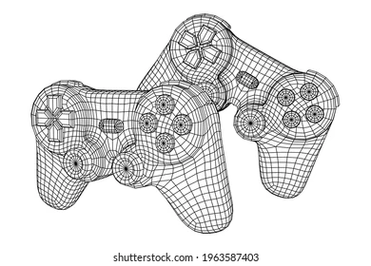
ABSTRACT
The main objective of developing gaming projects with Python is to enhance your overall ability and interaction while communicating with the programming language.
In this project we will learn the different patterns of object-oriented programming and develop your skills to the next level.
In our opinion, the best quality skill that we develop while working on solving gaming projects is the significant characteristic of planning.
Our team has developed an entire working plan and how the gaming project must look like from the beginning. This planning feature allows us to interpret and modify our code along our journey.

Slide 3

INTRODUCTION
Gaming is something that we have been passionate about since childhood.
The feeling when you realize that you can integrate your hobby into what you also love to work on, which is game development using python, in this case, is spectacular and sensational.
While gaming has always been something that has keenly piqued our interest, we were on the fence and quite unsure about programming.We became more intrigued by programming in game development in python.

Slide 4

We have designed this project as a small gaming console named “GAMETASTIC” which will provide both knowledge and joy to the players. It means ‘A Console Full of Funtastic Games’.
In this we have compiled some retro games that we have been playing since our childhood.
In these difficult times of pandemic and suffering we thought of making something which will free our minds from external torment. In this project we will try to give joy as well as some knowledge to whoever plays this game.

Slide 5
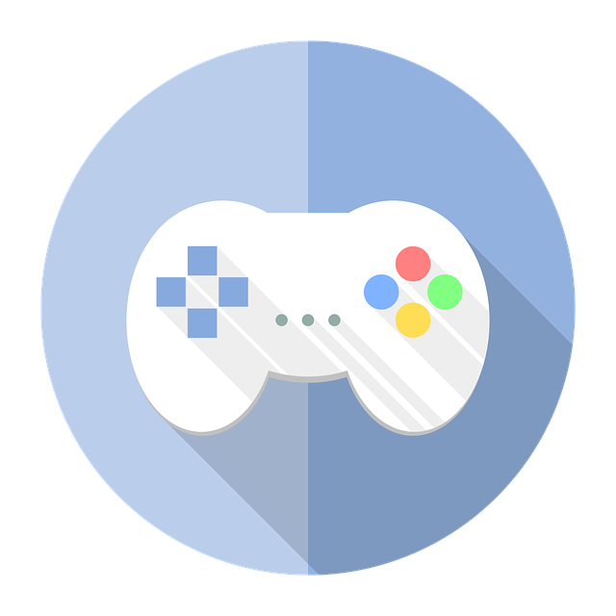
The games included in this project are :-
Ø Hangman
Ø Rock Paper Scissors
Ø Sliding Puzzle
Ø Fruit Ninja
Ø 2048
Ø Fate at Choices

Slide 6
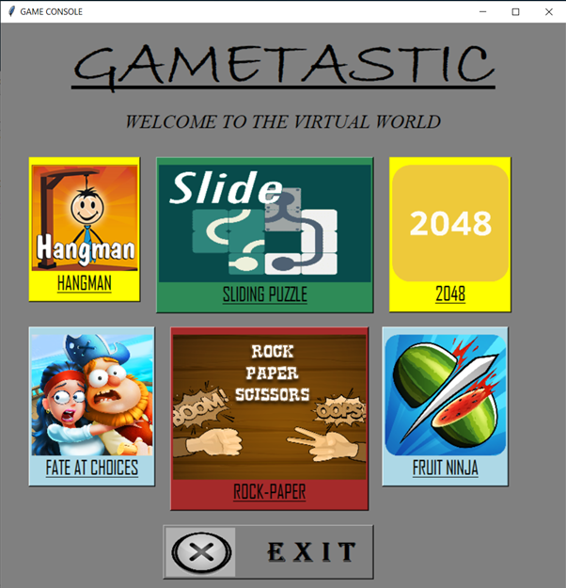
PROJECT
This project includes Six Games
on single platform, i.e.,
Python.
USER INTERFACE
This is the front page of our project.
It provides a simple interface to start the different
games that we have added into the project.

Slide 7
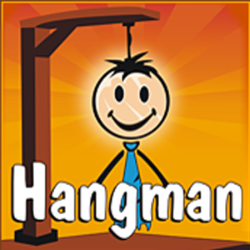
HANGMAN
Hangman is a popular word game in which one player (the "chooser") chooses a secret word and another player (the "guesser") attempts to guess the word one letter at a time.
If a guessed letter appears in the word, all instances of it are revealed.
If not, the guesser loses a chance.
If the guesser figures out the secret word before he or she runs out of chances, he or she wins.
If not, the player who chose the word wins.
Traditionally, chances are tracked using a stick figure drawing of a person being hanged from gallows. The figure is drawn one body part at a time, and the guesser loses when the entire figure has been drawn.

Slide 8
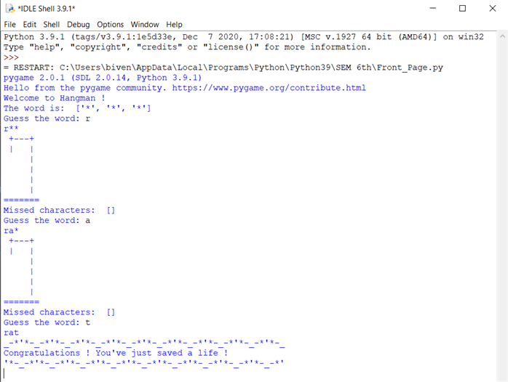
When we correctly guess a new word.

Slide 9
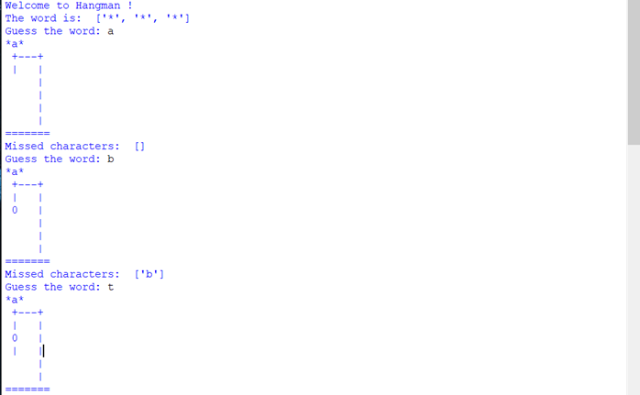
When the word is not guessed correctly and we
will lose all lives and man gets hanged.

Slide 10
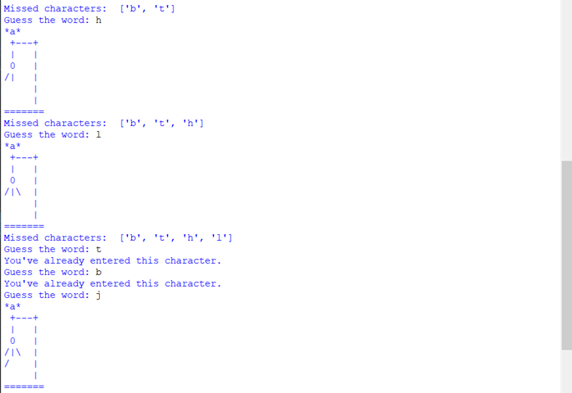
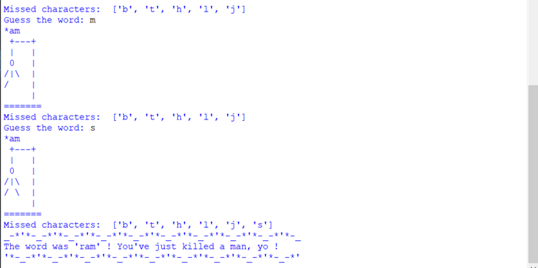

Slide 11
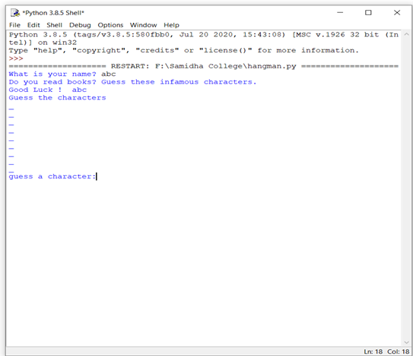
Different version of the hangman game.

Slide 12

SLIDING PUZZLE
A sliding puzzle, sliding block puzzle, or sliding tile puzzle is a combination puzzle that challenges a player to slide (frequently flat) pieces along certain routes (usually on a board) to establish a certain end-configuration.
The pieces to be moved may consist of simple shapes, or they may be imprinted with colours, patterns, sections of a larger picture (like a jigsaw puzzle), numbers, or letters.
Sliding puzzles are essentially two-dimensional in nature, even if the sliding is facilitated by mechanically interlinked pieces (like partially encaged marbles) or three-dimensional tokens.
As this example shows, some sliding puzzles are mechanical puzzles. However, the mechanical fixtures are usually not essential to these puzzles; the parts could as well be tokens on a flat board that are moved according to certain rules.

Slide 13
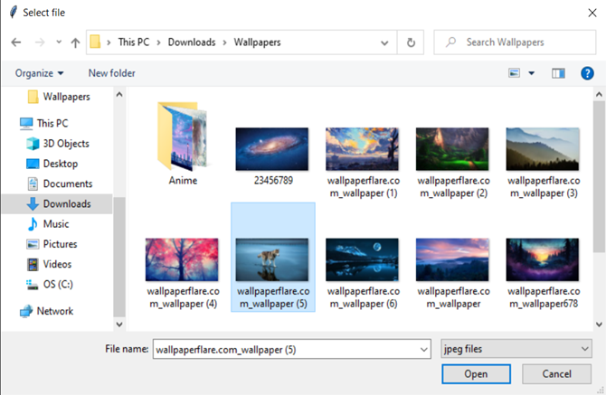
Here is the picture we need to select
from our directory while playing
sliding picture puzzle game.

Slide 14
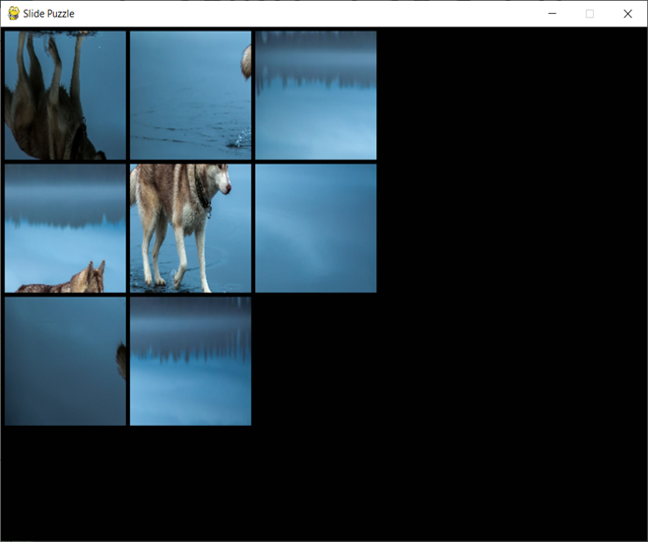
Here is the sliding picture puzzle
game on execution.

Slide 15
2048
2048 is often played on a plain 4×4 grid, with numbered tiles that slide when a player moves them using the four arrow keys.
Every turn, a new tile randomly appears in an empty spot on the board with a value of either 2 or 4. Tiles slide as far as possible in the chosen direction until they are stopped by either another tile or the edge of the grid.
If two tiles of the same number collide while moving, they will merge into a tile with the total value of the two tiles that collided. The resulting tile cannot merge with another tile again in the same move.
Higher-scoring tiles emit a soft glow, and the highest possible tile is 131,072. If a move causes three consecutive tiles of the same value to slide together, only the two tiles farthest along the direction of motion will combine.
If all four spaces in a row or column are filled with tiles of the same value, a move parallel to that row/column will combine the first two and last two.

Slide 16

A scoreboard on the upper-right keeps track of the user's score. The user's score starts at zero, and is increased whenever two tiles combine, by the value of the new tile. The game is won when a tile with a value of 2048 appears on the board, hence the name of the game.
After reaching the 2048 tile, players can continue to play (beyond the 2048 tile) to reach higher scores. When the player has no legal moves (there are no empty spaces and no adjacent tiles with the same value), the game ends.

Slide 17
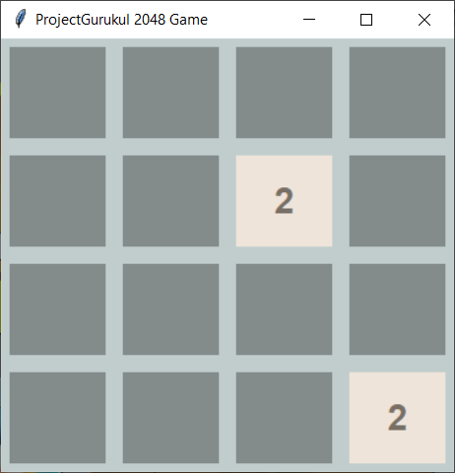
Starting Interface of 2048 game.

Slide 18
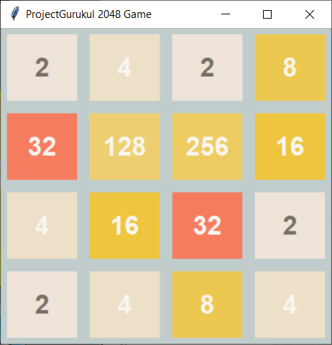
Game while execution

Slide 19
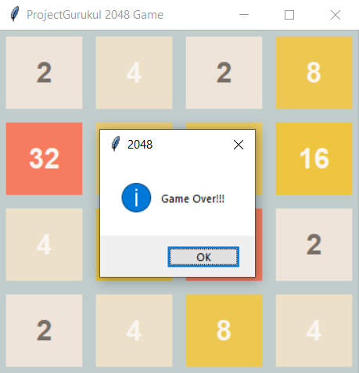
Game when 2048 is reached

Slide 20
FATE AT CHOICES
A Text-Based Adventure Game is a type of game in which a player has to make choices (Yes / No) in every step of the game.
Based on these choices, the storyline changes, and at last, we get to know that whether the player wins or loses the game.
a text-based game is any electronic game whereby information is conveyed as encoded text in the user interface.

Slide 21
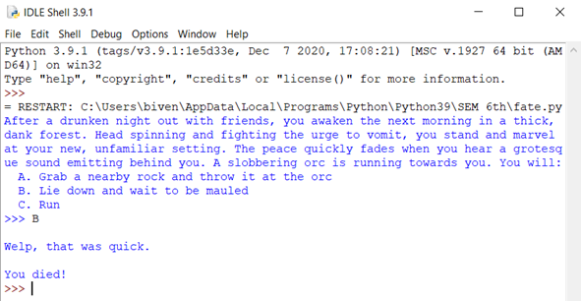
Here are the screenshots of different conditions
of the fate game when executed.

Slide 22
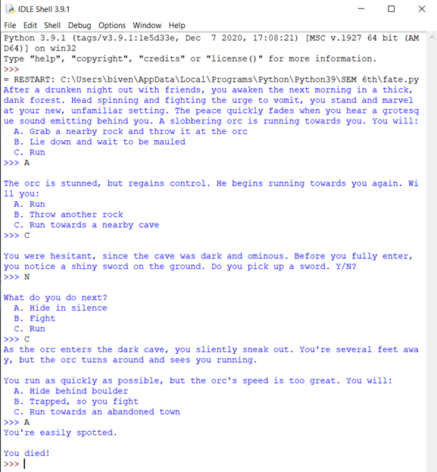
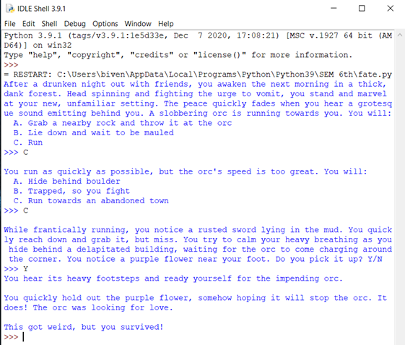

Slide 23
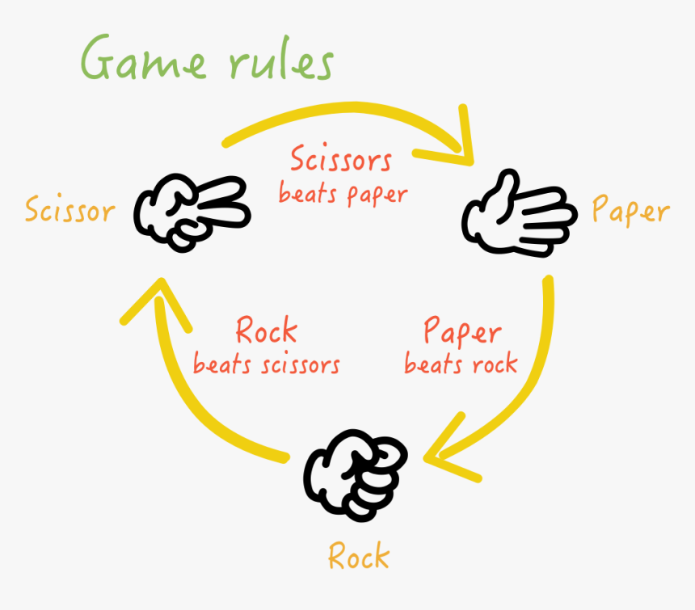
ROCK PAPER SCISSORS
The players may count aloud to three, or speak the name of the game (e.g., "Rock! Paper! Scissors!"), either raising one hand in a fist and swinging it down with each syllable or holding it behind their back. They then "throw" by extending it towards their opponent.
Variations include a version where players throw immediately on the third count (thus throwing on the count of "Scissors!"), or a version where they shake their hands three times before "throwing".

Slide 24
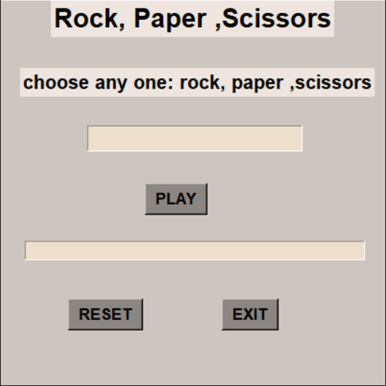
Game while execution

Slide 25
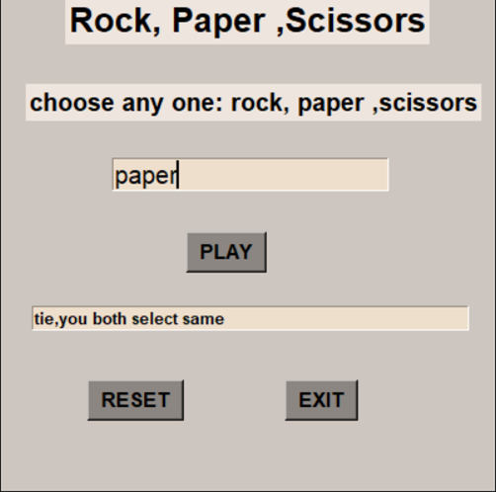
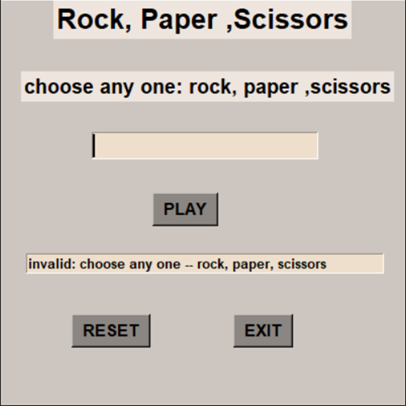

Slide 26


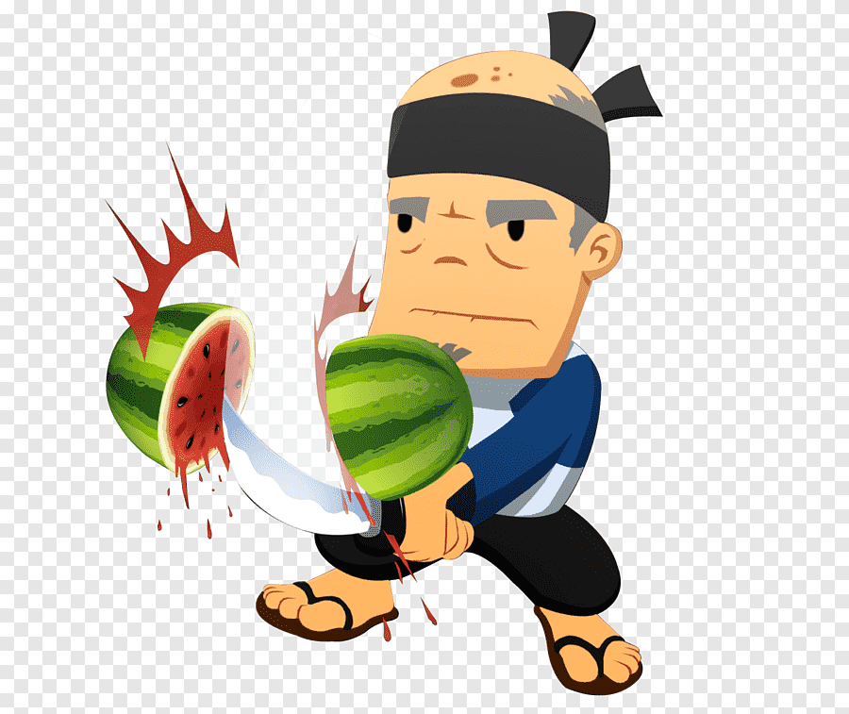
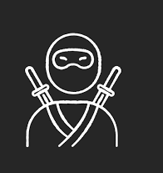
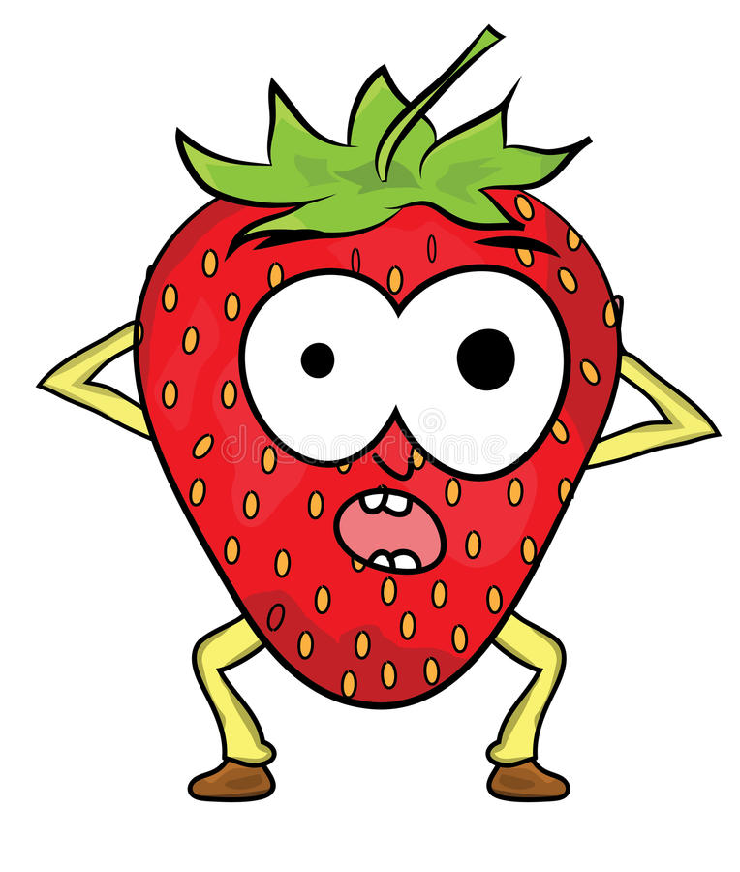

FRUIT NINJA
In Fruit Ninja, the player slices fruit with a blade controlled via the mouse. As the fruit is thrown onto the screen, the player swipes their mouse across the screen to create a slicing motion, attempting to slice the fruit in half.
Extra points are awarded for slicing multiple fruits with one swipe (called "combo’s). Players must slice all fruit; if three fruits are missed, the game ends, but upon reaching scores that are multiples of one hundred, the player will gain an extra life (unless they have not missed a piece of fruit already).
Bombs are occasionally thrown onto the screen, and will also end the game should the player slice them.

Slide 27
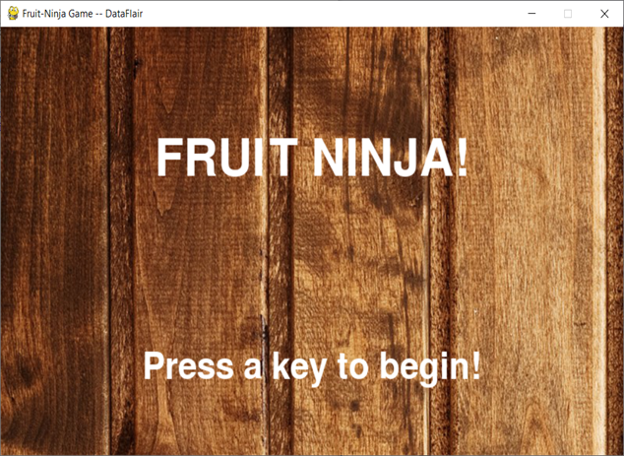
Start page of the fruit ninja game.

Slide 28
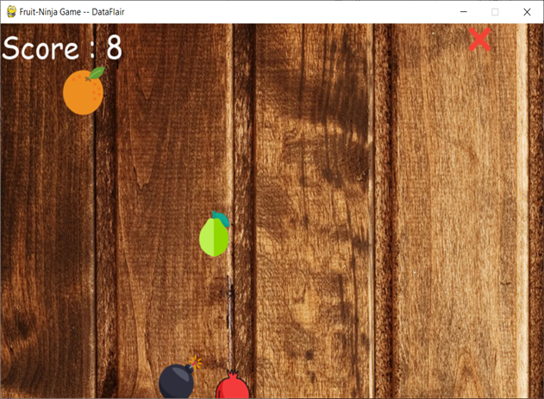
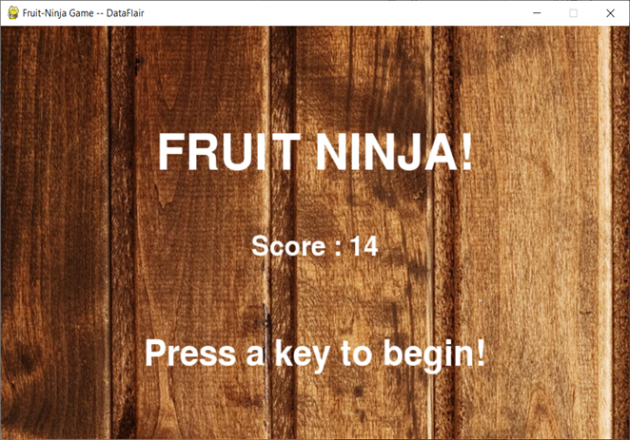

Slide 29


Conclusion & Scope
The project being basic is best suitable for:
Academic projects.
Beginners who want to try basic projects at hand.
Developers who wish to scoop up a new language for a change.
So, as per the future scope (modifications) that can be done in our project are:
Security
It can be rendered new with good graphics.
We can add more options like Top scores and Player Profile.
We can add multiplayer option.
We can fix the variables after continuous and multiple testing.

Slide 30

ROLES OF INDIVIDUAL
Biven Gupta - 1803659 (113/18) - Designing and Coding
CharuPadam Singh Parmar - 1803660 (114/18) - Designing and Coding
Samidha - 1803696 (150/18) – Testing and Error Fixing
Jagrit Puri - 1803667 (121/18) - Deployment and System Requirements

Slide 31


